Slide 1
Clinical Presentation and Pathophysiology of Gonorrhea
Student’s Name
Institution

Slide 2
Overview
Infection caused by sexually transmitted bacterium
Infects both male and females
In males, it affects urethra, rectum, and throat
In females, it affects the cervix
Spread through vaginal, oral, or anal sex
Babies can be infected during childbirth
Prevention include abstinence or protected sex
Notes:
This general overview shows the key concepts of gonorrhea. Gonorrhea is a condition caused by sexually transmitted bacterium. It can affect both male and females. This condition can also affect children, especially if the mother has it. This can occur during childbirth. However, for adults, gonorrhea can be contracted through viginal, oral, and anal sex. Therefore, the main way to protect oneself or prevent it is through abstinence or protected sex.

Slide 3
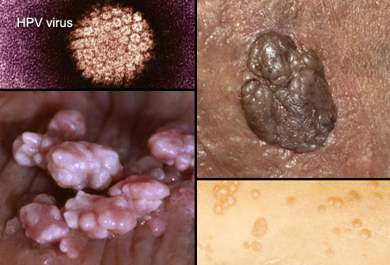
Clinical Representation
Clinical manifestation can vary depending on:
Severity
Gender
In many cases, there are no symptoms
But, when they emerge, it can affect many parts of the body
Mainly, the symptoms appear on genital tract
Notes:
In most cases, gonorrhea does not show any symptoms, especially during the early stages. This may push the condition to severe stage where, by the time one realizes and notices the symptoms, it has already affected some parts of the body. However, the main clinical manifestation is notable on the genital tract.

Slide 4
Clinical Manifestation in Male
Mucopurulent or urethral discharge
Dysuria
Anal discharge
Painful or burning urination
Pus-like discharge from the penis’ tip
Pain on the testicles
Swelling in one of the testicle
Itching around anus
Pain when one poops
Notes:
Among male patients, the clinical manifestation of gonorrhea can range from dysuria to mucopurulent or urethal discharge. However, there are other symptoms that can be noted to clinically help in diagnosing gonorrhea in male patients. These signs include feeling pain during urination, pain or swelling of one of the testicles, pain as one poops, and itching around the anus. All these manifestations emerge when the infection has started spreading in the body.

Slide 5
Clinical Manifestation in Females
Alterred vaginal discharge
Can be water, thin, yellow or green
Dysuria
Dyspareunia
Lower abnominal pain (Hill et al., 2016)
Mucopurulent endocervical discharge
Induced cervical bleeding
Pelvic tenderness (Hill et al., 2016)
Notes:
Clinical manifestation of genital infection for female patients include the most commonly and observable signs like altered and increased vaginal discharge. This discharge is common thin, watery and may be green or yellow in color.

Slide 6
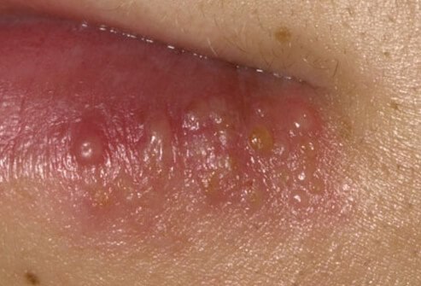
Pathophysiology
If left untreated, gonorrhea can lead to various health complications
Complications include:
    Pelvic inflammatory diseases (females)
    PID can also lead to chronic pain
    Infertility
    Ectopic pregnancy
Patients with severe PID should seek medical treatment to curb more risks
Notes:
The pathophysiology of gonorrhea condition shows that if left untreated, this condition can cause more health problems to the patient. For female patients, complications that can develop include PID, chronic pain, infertility, and ectopic pregnancy. Therefore, these conditions can be avoided if one notices the clinical manifestations and seek medical treatment immediately.

Slide 7
Continuation of Pathophysiology
Spread through unprotected:
      Vaginal
      Anal
      Oral sex
Can be transmitted from mother to child
Neisseria gonorrhoeae-gram-negative diplococcus
Strong affinity for mucous membranes
Invades the host cell
Acute inflammation
Notes:
Gonorrhoea is spread through unprotected anal, vaginal, and oral sex. However, it can also be vertically transmitted from the mother to the child during the child birth. The pathophysiology of gonorrhoea is associated with the infection of the mucus membranes. This explains why the condition affects mostly uterus, urethra, fallopian tubes, ovaries, testicles, rectum, throat, and cervix. However, it rarely affects the eye. Once neisseria gonorrhoea, which is a gram-negative diplococcus, attaches itself to the mucous membranes, it invades the host cell and may cause acute inflammation.

Slide 8
Complications in Men
In males, gonorrhea can result in:
Epididymo-orchitis-can lead to infertility
Prostatits
Disseminated gonococcal infection (DGI) (Piszczek et al., 2015)
Joint pain
Skin lesions
Reactive arthritis (Piszczek et al., 2015)
Notes:
As Piszczek et al. (2015) explain, gonococcal infections are mostly considered uncomplicated and if left untreated, it can spread to the other parts of the genitals, causing more damage. In rare cases, gonorrhea has been linked to reactive arthritis in men.

Slide 9
Treatment and Management
After diagnosis, patient with gonorrhea should be treated
The treatment includes a single dose of intramuscular ceftriaxone 1g
STIs screening should be offered regularly
This will prevent reinfections and common co-infections
Patients should contact their previous sexual partners to be screened
Notes:
Treatment of gonorrhea involves admission of a single dose of intramuscular ceftriaxone 1g. However, further screenings should be done to ensure that the patient is safe from co-infections that are commonly associated with gonorrhea. Also, patients should be advised to contact and bring their sexual partners for them to be screened and treated.

Slide 10
References
Hill, S. A., Masters, T. L., & Wachter, J. (2016). Gonorrhea-an evolving disease of the new millennium. Microbial cell, 3(9), 371.
Piszczek, J., St. Jean, R., & Khaliq, Y. (2015). Gonorrhea: Treatment update for an increasingly resistant organism. Canadian Pharmacists Journal/Revue des Pharmaciens du Canada, 148(2), 82-89.

